Slide 1



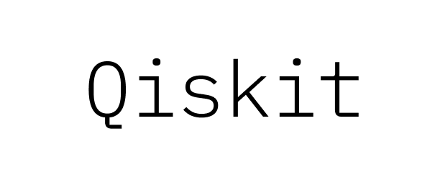

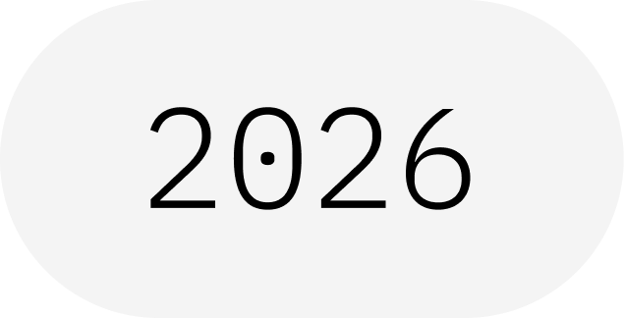
OFFICIAL EVENT
Parameter— Parameter Vector
Qiskit Fall Fest 2026 at University of Engineering & Technology Lahore,Narowal Campus

Slide 2
TABLE OF CONTENTS
01
02
03
04
05
02
PARAMETERIZED CIRCUIT (ANSATZ)
PARAMETER AND THE THREE ANSÄTZE
BINDING VALUES AND CHOOSING THE ANSATZ
PARAMETERS IN THE OPTIMIZATION LOOP
PARAMETERVECTOR (OPTIONAL APPENDIX)
Qiskit Fall Fest 2026 at University of Engineering & Technology Lahore,Narowal Campus

Slide 3
Parameterized circuit (ansatz)
03
Qiskit Fall Fest 2026 at University of Engineering & Technology Lahore,Narowal Campus

Slide 4
Parameterized circuit (ansatz)
04
The second component is the parameterized quantum circuit, a special quantum circuit with adjustable parameters, similar to dials on a radio.
We need a one-qubit parameterized quantum circuit as an ansatz.
The "coverage" refers to the range of quantum states that the ansatz circuit can produce by varying its parameters.
A more flexible ansatz has the potential to find a better approximation, but it might also be harder for the classical optimizer.
Qiskit Fall Fest 2026 at University of Engineering & Technology Lahore,Narowal Campus

Slide 5
Parameter and the three ansätze
05
from qiskit.circuit import Parameter
theta = Parameter("θ")
phi = Parameter("φ“ )
lam = Parameter("λ“)
ansatz1 = QuantumCircuit(1)
ansatz1.rx(theta, 0)
ansatz2 = QuantumCircuit(1)
ansatz2.rx(theta, 0)
ansatz2.rz(phi, 0)
ansatz3 = QuantumCircuit(1)
ansatz3.rx(theta, 0)
ansatz3.rz(phi, 0)
ansatz3.rx(lam, 0)
Qiskit Fall Fest 2026 at University of Engineering & Technology Lahore,Narowal Campus

Slide 6
Parameter and the three ansätze
06
One 1-axis rotational gate ansatz: rotations around only a single axis (Rx(θ)). This is the least flexible and covers a limited set of states.
Two 2-axis rotational gate ansätze: Rx(θ1)Rz(θ2) and Rx(θ1)Rz(θ2)Rx(θ3). This allows us to reach a larger portion of the Bloch sphere.
Qiskit Fall Fest 2026 at University of Engineering & Technology Lahore,Narowal Campus

Slide 7
Binding values and choosing the ansatz
07
bound_qc = qc.assign_parameters(
{theta: theta_vals[i], phi: phi_vals[i], lam:lam_vals[i]})
Generate 5000 random numbers for each parameter.
First ansatz: ring-shaped distributed quantum states of the Bloch sphere.
Second ansatz: covers a larger portion of the Bloch sphere - but the dots are more concentrated around the poles and more spread out around the equator.
Last ansatz: more evenly distributed quantum states.
For simplicity, we will stick with ansatz 3, which uniformly probes the entire Bloch sphere.
Qiskit Fall Fest 2026 at University of Engineering & Technology Lahore,Narowal Campus

Slide 8
Binding values and choosing the ansatz
08
num_params = ansatz.num_parameters
Output: This circuit has 3 parameters
You can see the rx, rz gates of our ansatz were converted into a series of rz, sx gates, which are the native gates of our backend.
Qiskit Fall Fest 2026 at University of Engineering & Technology Lahore,Narowal Campus

Slide 9
Parameters in the optimization loop
09
The classical optimizer determines the next set of optimized parameters for the quantum ansatz. These updated parameters are then sent back to the quantum circuit, and the process is repeated.
pub = (ansatz, [hamiltonian], [params])
result = estimator.run(pubs=[pub]).result()
energy = result[0].data.evs[0]
Qiskit Fall Fest 2026 at University of Engineering & Technology Lahore,Narowal Campus

Slide 10
Parameters in the optimization loop
10
We prepare initial parameters for our ansatz and its optimization process. You can simply use all zeroes or random values.
x0 = [1, 1, 0] # hydrogen atom
x0 = [2, 0, 0] # H2 molecule (same ansatz reused)
Qiskit Fall Fest 2026 at University of Engineering & Technology Lahore,Narowal Campus

Slide 11
Parameters in the optimization loop
11
from qiskit.circuit import ParameterVector
num_iter = 4
alpha = ParameterVector("alpha", 3)
beta = ParameterVector("beta", 3 * num_iter)
ansatz_2 = QuantumCircuit(1)
for i in range(num_iter):
ansatz_2.rx(beta[i * 3 + 0], 0)
ansatz_2.rz(beta[i * 3 + 1], 0)
ansatz_2.rx(beta[i * 3 + 2], 0)
.
Qiskit Fall Fest 2026 at University of Engineering & Technology Lahore,Narowal Campus

Slide 12
Parameters in the optimization loop
12
Many ansätze introduce excessive variational parameters that contribute little to improving accuracy but significantly increase optimization difficulty.
The optimization process becomes intractable as the number of parameters increases, leading to slow convergence and difficulties in finding the optimal solution.
This highlights a well-known challenge in Variational Quantum Eigensolver (VQEs): the overhead of the optimizer.
Qiskit Fall Fest 2026 at University of Engineering & Technology Lahore,Narowal Campus

Slide 13
Real-World Quantum Applications
1- Cryptography and Cybersecurity
2- Climate Modeling and Weather Prediction
3- Artificial Intelligence and Machine Learning
4- Material Science and Chemistry
5- Energy Optimization
6- Space Research and Exploration

Slide 14
THANKS!
DO YOU HAVE ANY QUESTIONS?
13
Qiskit Fall Fest 2026 at University of Engineering & Technology Lahore,Narowal Campus

